Slide 1
ESOPHAGEAL RUPTURE
By
Dr. Hussein AlNaji

Slide 2
ETIOLOGY
localized ischemia and necrosis secondary to foreign bodies.
External trauma, nasogastric intubation.
Perforation of ulcers in horses and cattle.
Death of Hypoderma lineatum larvae in cattle.
Spontaneous rupture can occur in horses with idiopathic muscular hypertrophy of the esophagus.
The administration of sustained-release anthelmintic boluses to young calves not large enough for the size of the bolus used can cause esophageal injury and perforation.

Slide 3

PATHOGENESIS
Traumatic injury to the esophagus
edema, hemorrhage, laceration of the mucosa
Possible perforation of the esophagus resulting in periesophageal cellulitis
Perforation of the thoracic esophagus caused fatal pleuritis
spreads proximally and distally along the esophagus
severe toxemia, and dysphagia can cause aspiration pneumonia.
extensive edema and accumulation of swallowed or regurgitated ingesta along with gas.

Slide 4
CLINICAL FINDINGS
In the acute injury of the esophagus, there is salivation and attempts to swallow, which cause severe pain, particularly in horses.
In some cases, attempts at swallowing are followed by regurgitation and coughing, pain, retching activities, and vigorous contractions of the cervical and abdominal muscles.
Marked drooling of saliva, grinding of the teeth, coughing, and profuse nasal discharge are common in the horse with esophageal trauma with complications following nasogastric intubation.

Slide 5
4- Regurgitation can occur and the regurgitus contains mucus and some fresh blood.
5- If the esophageal rupture is in the cervical region, palpation in the jugular furrow causes pain and edematous tissues around the esophagus can be palpable.
CLINICAL PATHOLOGY
There is often hematological evidence of inflammation, dehydration, metabolic alkalosis, and toxemia.

Slide 6
DIFFERENTIAL DIAGNOSIS
Tracheal laceration and subcutaneous emphysema
Skin wounds over the axilla with subsequent subcutaneous emphysema.
Severe guttural pouch empyema.
Clostridial myositis secondary to puncture wounds of the neck or cervical intramuscular injections.
Pharyngeal phlegmon in cattle

Slide 7
TREATMENT
Treatment involves effective drainage of the site over the esophageal perforation.
prevention of further contamination, control of infection and inflammation, and provision of water and food.
Surgical treatment involves fasciotomy to provide drainage and access to the perforated esophagus.
A stomach tube, of similar size as that used to perform nasogastric intubation on the animal (14–20 mm).
Broad-spectrum antimicrobials and tetanus prophylaxis should be administered. Pain and swelling can be controlled by administration of NSAIDs.

Slide 8
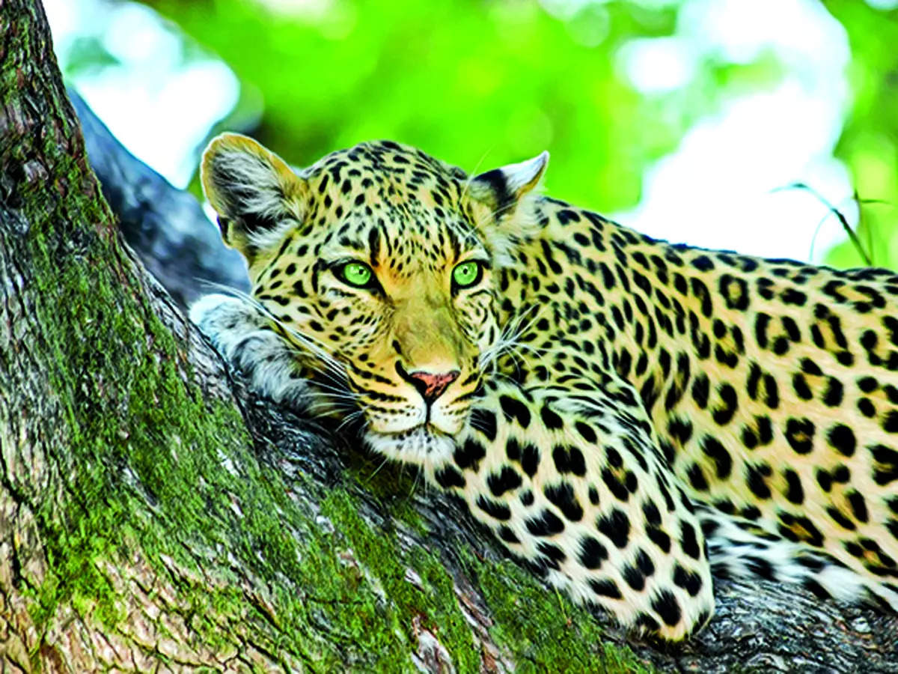
THANK YOU

